Slide 1
Lecture 10: Modeling using Graph Theory
Using mathematical tools to explore real-world problems.
Ref: Textbook Chapter 8

Slide 2
A Graph
4
5
6
1
3
2
Nodes (vertices) and links (edges, arcs)
Nodes: Locations, people, atoms, …
Links: Distances, delay measures, cost, strength of relationship

Slide 3
Graph Theory - History
The origin of graph theory - Euler's work on the Konigsberg bridges problem (Euler’s problem, 1735).

Slide 4
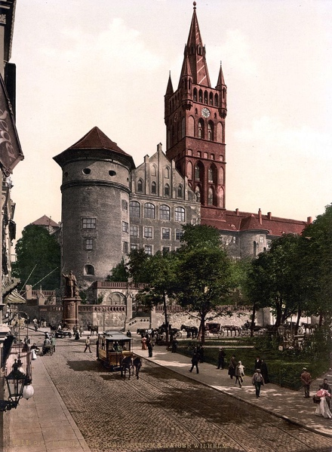
Konigsberg
An ancient city of Prussia and Germany
Largely destroyed in World War II.
Now Kaliningrad, Russia
Konigsberg castle before World War I
Source: https://en.wikipedia.org/wiki/K%C3%B6nigsberg

Slide 5
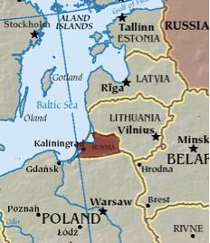
Location of Konigsberg/Kaliningrad
Now a Russian exclave between Poland and Lithuania
Source: https://saratamsaratyt.wordpress.com/2013/06/10/kaliningrad-or-the-city-formerly-known-as-konigsberg/

Slide 6
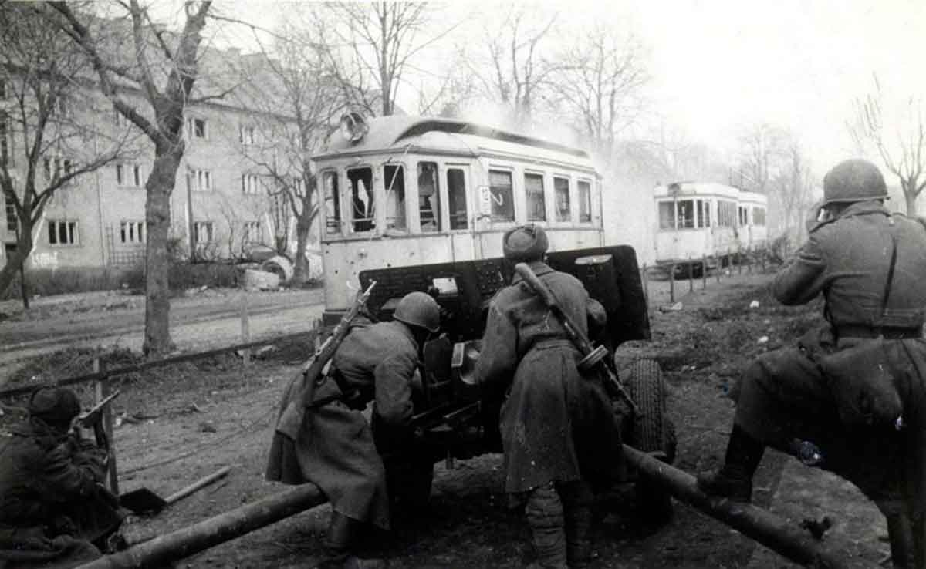
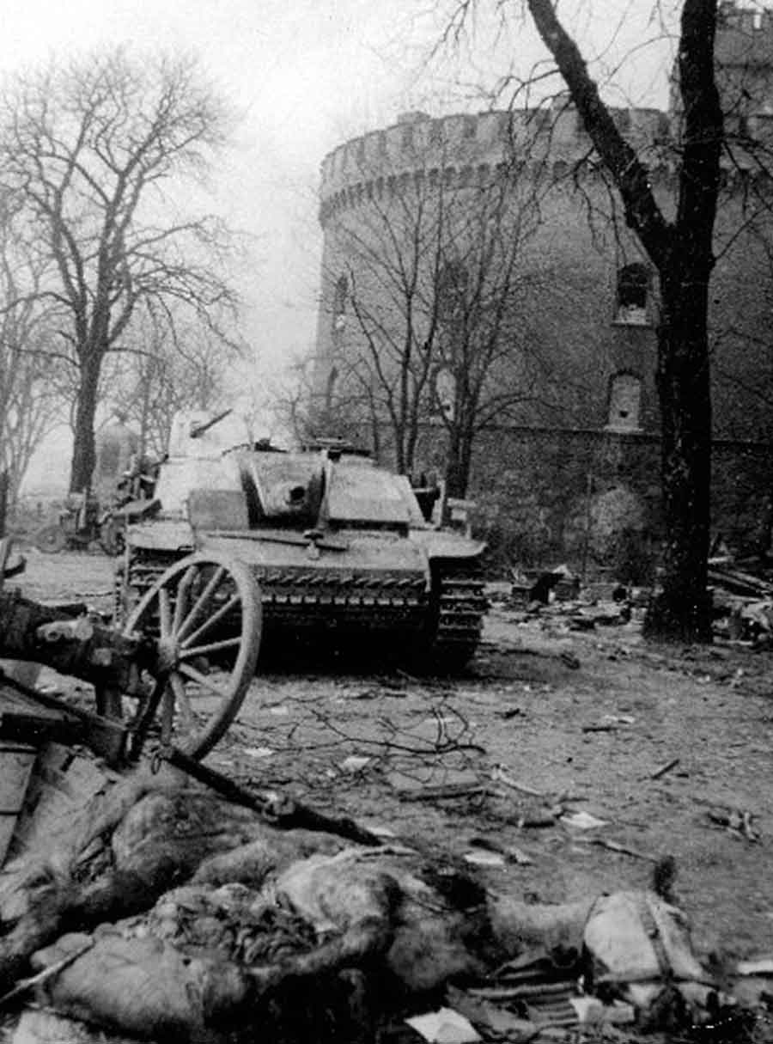
Battle of Konigsberg (1945)
Destruction of Konigsberg streets
Soviet red army troops fighting in Konigsberg
Source: http://ww2today.com/11-april-1945-the-rape-and-loot-of-konigsberg-capital-of-prussia

Slide 7
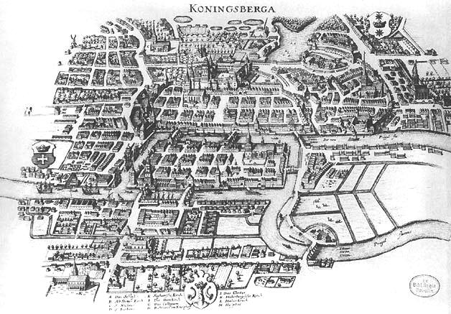
Map of Konigsberg (1641)
3
4
5
6
2
1
7
Seven bridges are shown on the map
Source: https://en.wikipedia.org/wiki/K%C3%B6nigsberg

Slide 8
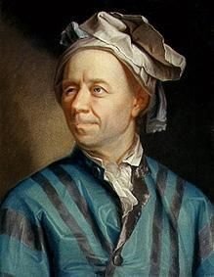

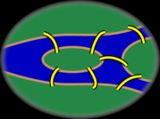
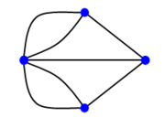
Graph Theory - History
Leonhard Euler's paper on “Seven Bridges of Konigsberg ” .
Problem : Start and end at the same point, walk all 7 bridges without crossing a bridge twice
Source: https://en.wikipedia.org/wiki/Seven_Bridges_of_K%C3%B6nigsberg

Slide 9
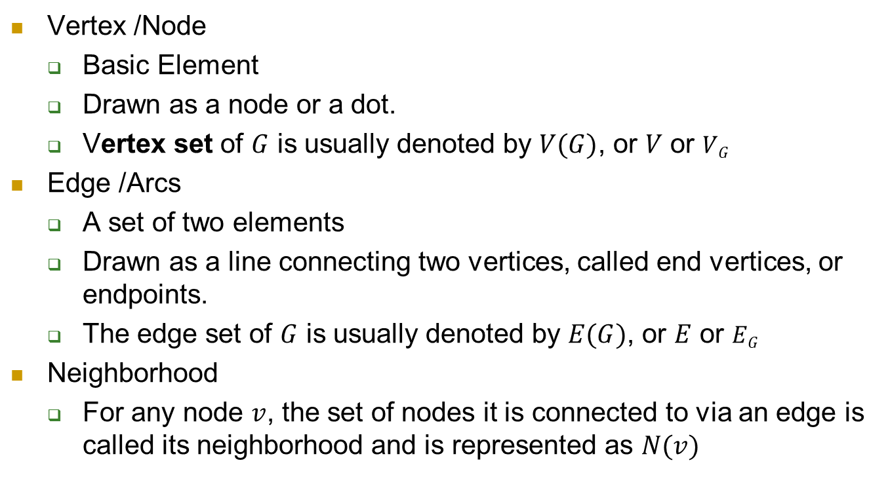
Graph Terminologies: Node & Edge
Vertex /Node
Basic Element
Drawn as a node or a dot.
Vertex set of $G$ is usually denoted by $V(G)$, or $V$ or $VG$
Edge /Arcs
A set of two elements
Drawn as a line connecting two vertices, called end vertices, or endpoints.
The edge set of $G$ is usually denoted by $E(G)$, or $E$ or $EG$
Neighborhood
For any node $v$, the set of nodes it is connected to via an edge is called its neighborhood and is represented as $N(v)$

Slide 10
Degree
Number of edges incident on a node
6
The degree of 5 is 3
4
5
1
3
2

Slide 11
Trail & Walk
trail: a sequence of connected nodes where no edge can be repeated
a-b-c-d-e-b-d
walk: a sequence of connected nodes where edges/nodes can be repeated.
a-b-d-a-b-c
A closed walk has the same starting and ending node

Slide 12
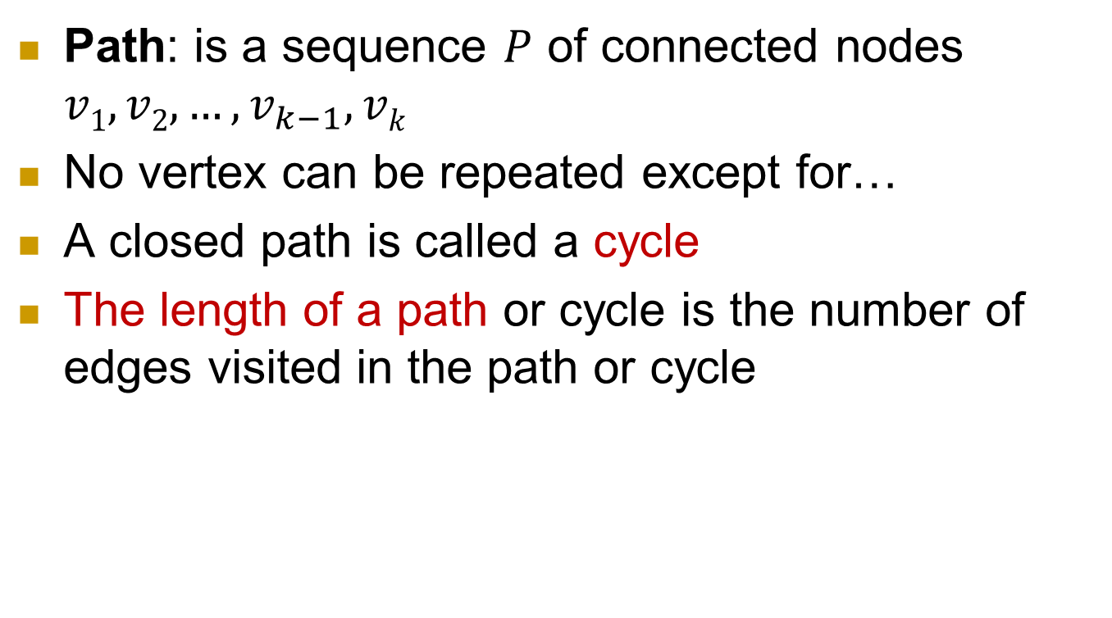
Paths
Path: is a sequence $P$ of connected nodes $v1, v2, …, v_{k−1}, vk$
No vertex can be repeated except for…
A closed path is called a cycle
The length of a path or cycle is the number of edges visited in the path or cycle
6
4
5
1
3
2
Walks and Paths
1,2,5,2,3,4 1,2,5,2,3,2,1 1,2,3,4,6
walk of length 5 CW of length 6 path of length 4

Slide 13
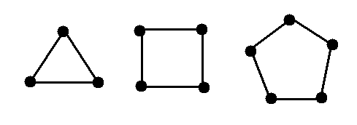
Cycle
Cycle - closed path: cycle (a-b-c-d-a)
Cycles denoted by C_{k}, where k is the number of nodes in the cycle
b
a
c
d
C₃ C₄ C₅

Slide 14
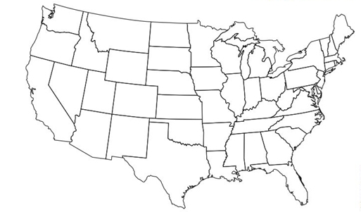
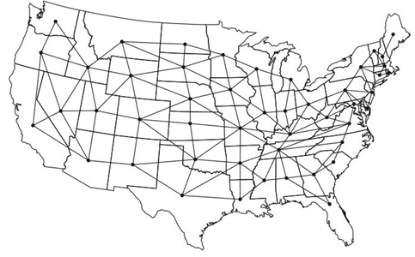
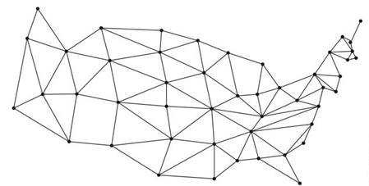
Application: Four-color mapping
No more than four colors are required to color a simple map such that no adjacent regions share the same color
Consider a map as a graph, two regions (nodes) sharing a border are connected by an edge

Slide 15
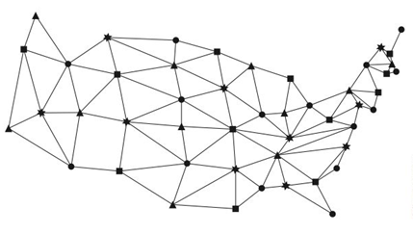
Color denoted by shapes

Slide 16
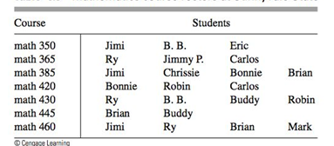
Application of graph coloring: scheduling
The Mathematics Department at a small college plans to schedule final exams. The class rosters for all the upper-class math courses are listed in the following table. Find an exam schedule that minimizes the number of time periods used.

Slide 17
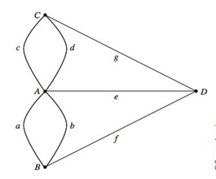
Back to Euler’s Problem
Eulerian graph: a graph, in which it is possible to find a closed walk that traverses every edge exactly once
Conditions for a graph to be Eulerian
Connected
Every node has even degree
The graph of Konigsberg is NOT Eulerian.

Slide 18
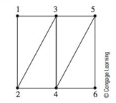
Relaxation of Euler’s Problem
If we relax the requirement of the walk so that the walker need not start and end at the same land mass but still must traverse every bridge exactly once, is this type of walk (semi-Eulerian) possible for the graph of Konisgberg?
How about this graph?

Slide 19
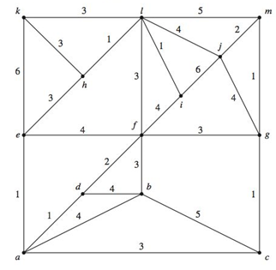
Extension of Euler’s Problem: Chinese Postman Problem
An inspector wants to examine the region represented by the following graph, find a way to minimize the total distance (weight of edges).

Slide 20
Shortest Path Problem
Shortest Path is the path between two nodes that has the shortest length
Length – number of edges.
Distance between u and v is the length of a shortest path between them
The diameter of a graph is the length of the longest shortest path between any pairs of nodes in the graph

Slide 21
Single-Source Shortest Path Problem
The problem of finding shortest paths from a source vertex v to all other vertices in the graph.
6
4
5
1
3
2

Slide 22
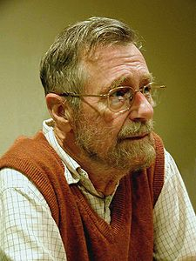
Edsger Wybe Dijkstra
May 11, 1930 – August 6, 2002
Received the 1972 A. M. Turing Award
- Made a strong case against use of the GOTO statement in programming languages and helped lead to its deprecation.
Known for his many essays on programming
Source: http://www.cs.utexas.edu/~EWD/

Slide 23
Dijkstra's algorithm
Dijkstra's algorithm - is a solution to the single-source shortest path problem in graph theory.
Works on both directed and undirected graphs. However, all edges must have nonnegative weights.
Approach: Greedy
Input: Weighted graph G={E,V} and source vertex v∈V, such that all edge weights are nonnegative
Output: Lengths of shortest paths (or the shortest paths themselves) from a given source vertex v∈V to all other vertices

Slide 24
Dijkstra's algorithm - Pseudocode
dist[s] ←0 (distance to source vertex is zero) for all v ∈ V–{s} do dist[v] ←∞ (set all other distances to infinity) S←∅ (S, the set of visited vertices is initially empty) Q←V (Q, the queue initially contains all vertices) while Q ≠∅ (while the queue is not empty) do u ← mindistance(Q,dist)
(select the element of Q with the min. distance) S←S∪{u} (add u to list of visited vertices)
Q←Q - {u} for all v ∈ neighbors[u] do if dist[v] > dist[u] + w(u, v) (if new shortest path found) then d[v] ←d[u] + w(u, v)(set new value of shortest path)
return dist

Slide 25
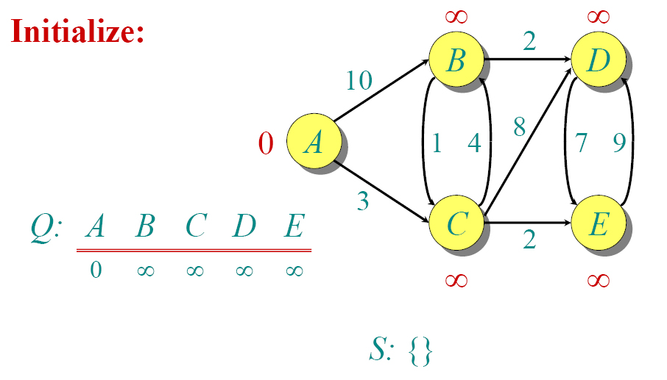
Dijkstra Animated Example

Slide 26
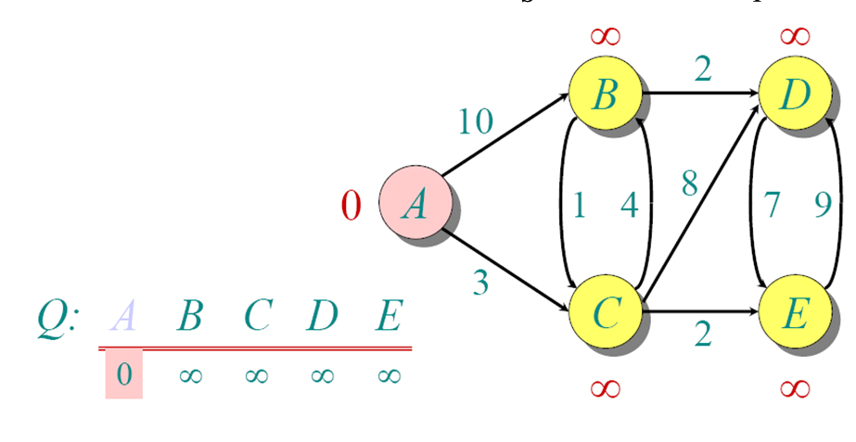
Dijkstra Animated Example

Slide 27
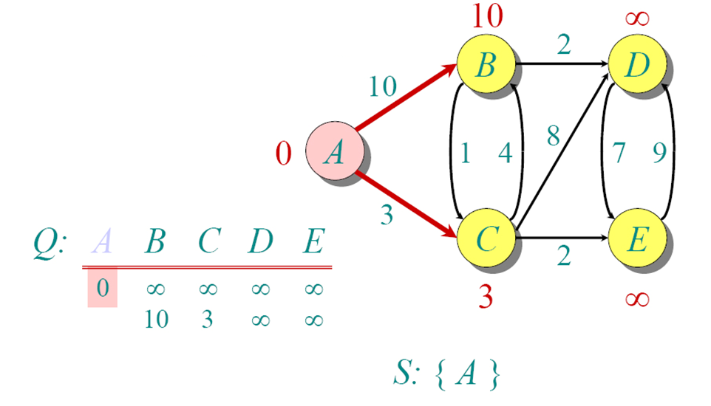
Dijkstra Animated Example

Slide 28
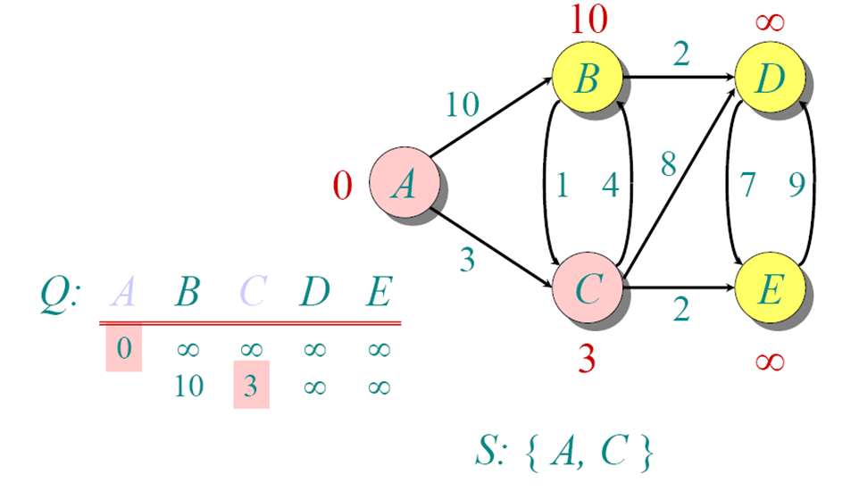
Dijkstra Animated Example

Slide 29
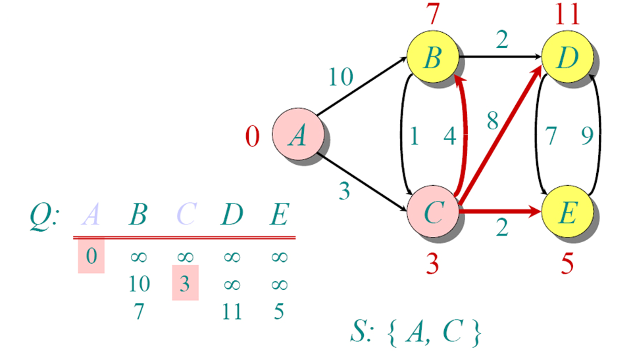
Dijkstra Animated Example

Slide 30
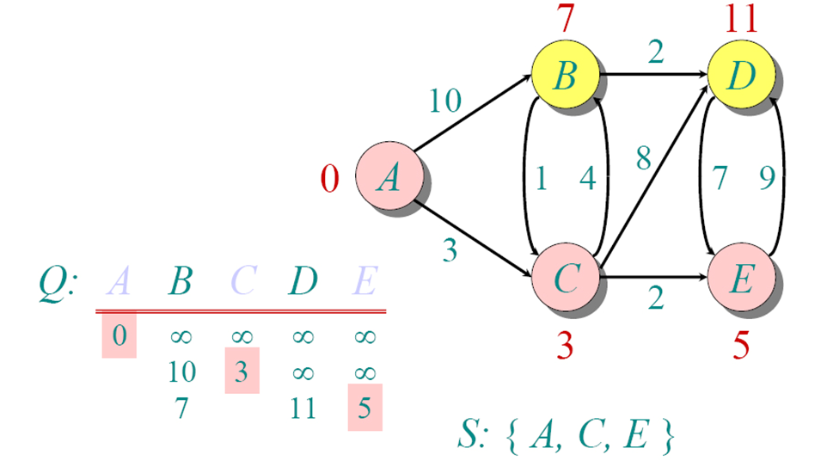
Dijkstra Animated Example

Slide 31
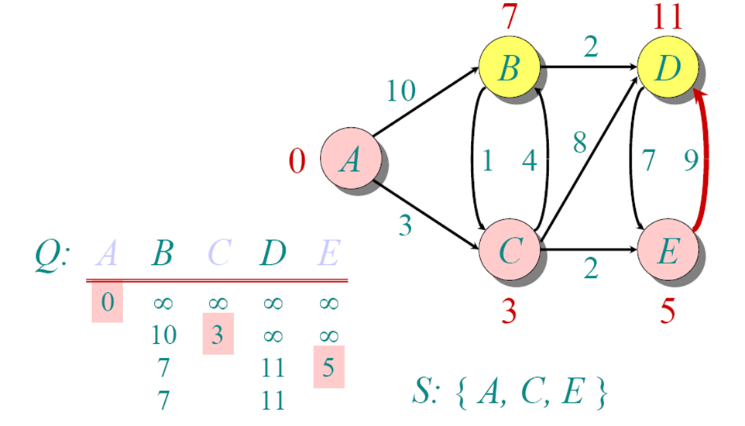
Dijkstra Animated Example

Slide 32
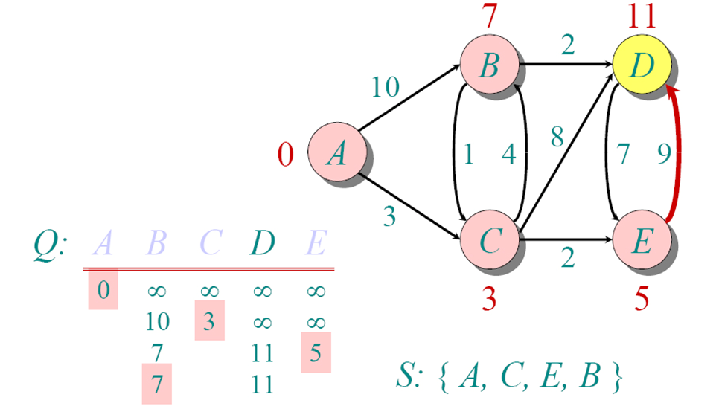
Dijkstra Animated Example

Slide 33
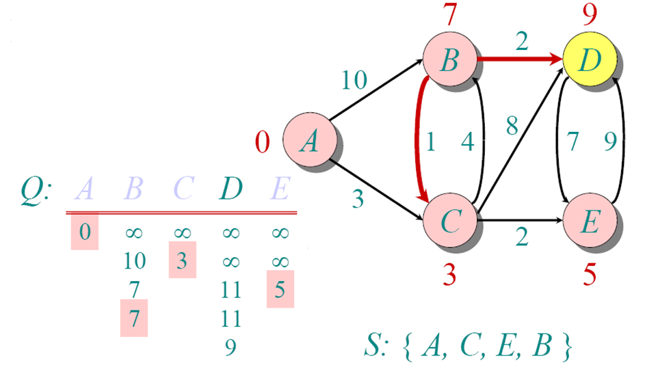
Dijkstra Animated Example

Slide 34
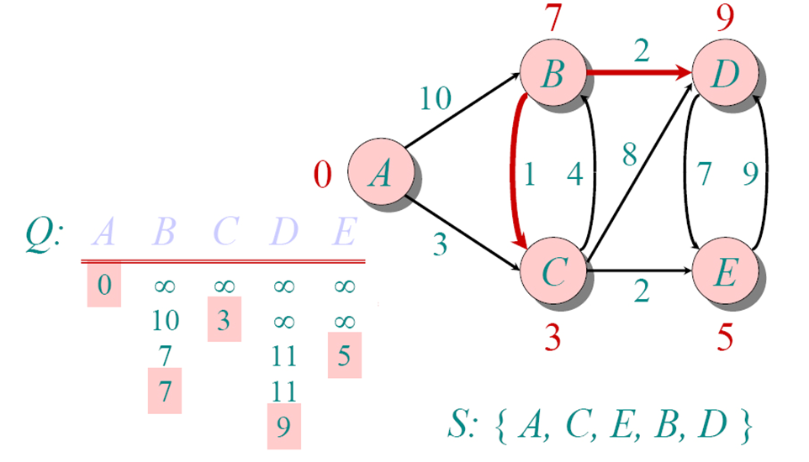
Dijkstra Animated Example

Slide 35
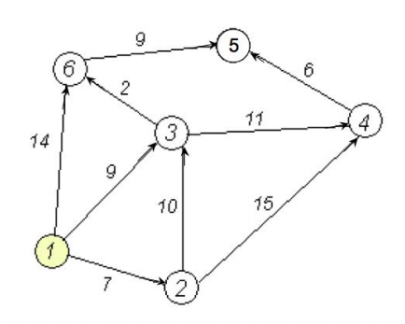
Exercise: solve the following shortest-path problem by Dijkstra’s Algorithm

Slide 36
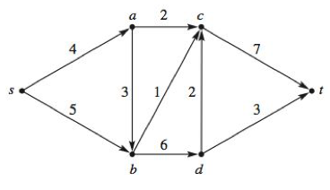
Maximum flow problem
Given a directed graph G, two specific vertices s and t, and a finite flow capacity u_{i,j} for each edge (i,j), the objective is to find a maximum flow from s to t in G.

Slide 37
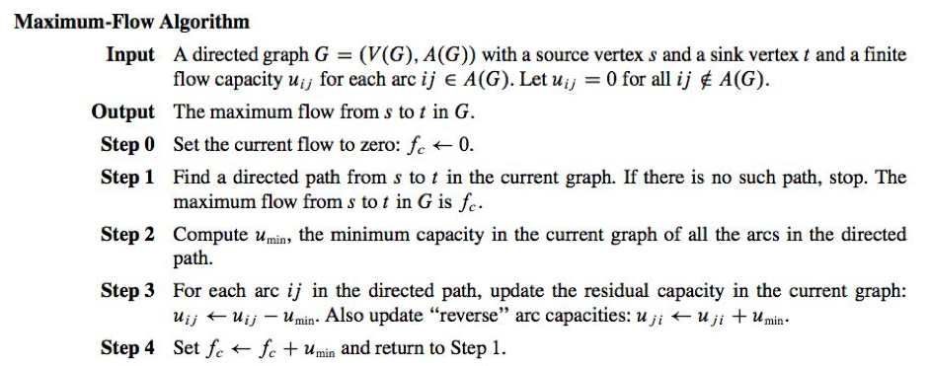

Slide 38
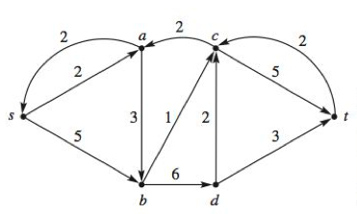
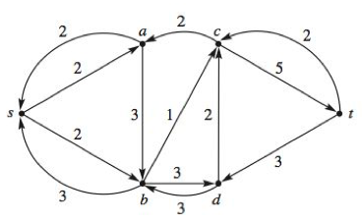
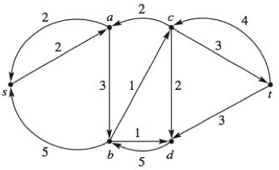
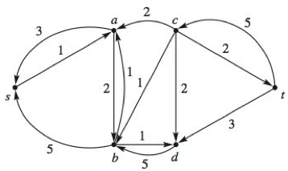

Slide 39
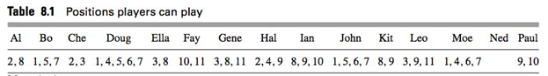
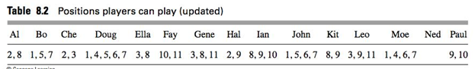
Matching Problem
Consider a baseball team with 15 players on its roster, each player can play different positions (11 positions in total)
Can you find an assignment in which 11 starters are in a position that they can play?
What if we (slightly) the players’ talents?

Slide 40
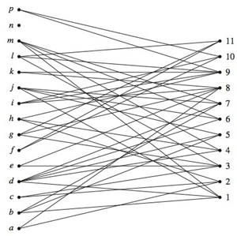
Bipartite graph
Nodes are partitioned into two groups
All edges have one end in Group A and the other end in Group B.

Slide 41
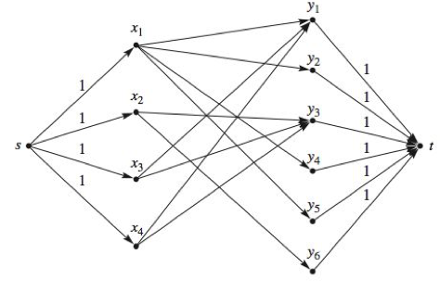
Use maximum flow algorithm to solve matching problem
Add a source node s and a sink node t to the bipartite graph and apply the maximum flow algorithm.
Each edge has a capacity of 1

Slide 42
Graph Theory and Linear Programming
We can use methods in linear programming, such as the simplex method, to solve problems in graph theory.

Slide 43
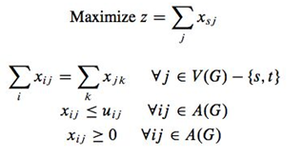
Linear programming in maximum flow problem
Consider a directed graph G = (V(G), A(G)), a source node s, and a sink node t, and a flow capacity u_{ij} for every edge ij in A(G).
Let x_{ij} represent the flow from node i to j, then the corresponding linear programming model is

Slide 44
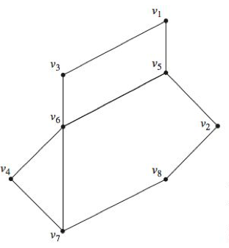
Vertex cover problem
Suppose a policeman at a road intersection can police all roads immediately incident with that intersection
Question: what’s the least number of policemen required to police a city?
Vertices: intersections
Edges: roads

Slide 45
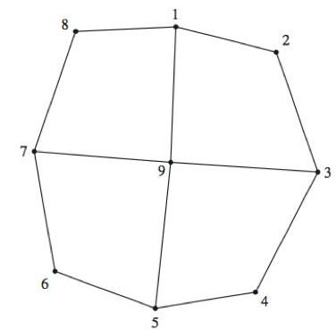
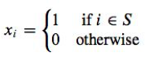
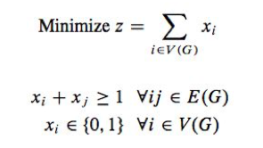
Linear programming on vertex cover problem
indicates whether vertex i is selected
subject to

Slide 46
Shortest-Route Problem
Shortest-path problem by Linear programming
Linear Programming Formulation
Using the notation:
x_{ij} = 1 if the arc from node i to node j
is on the shortest route
0 otherwise
c_{ij} = distance, time, or cost associated
with the arc from node i to node j
continued

Slide 47




Shortest-Route Problem
Shortest-path problem by Linear programming
Linear Programming Formulation (continued)
$$Min\sum_{all arcs}{c_{ij}x_{ij}}$$
$$\sum_{arcs out}{x_{sj}}=1$$
s.t.
Origin nodes s
$$\sum_{arcs out}{x_{jk}}−\sum_{arcs in}{x_{ij}}=0$$
Transshipment nodes j
$$\sum_{arcs in}{x_{it}}=1$$
Destination nodes t
x_{ij} > 0 for all i and j
continued

Slide 48
Example: Shortest-Route
Example
Susan Winslow has an important business meeting
in Paducah this evening. She has a number of alternate routes by which she can travel from the company headquarters in Lewisburg to Paducah. The network of alternate routes and their respective travel time, ticket cost, and transport mode appear on the next two slides.
If Susan earns a wage of $15 per hour, what route
should she take to minimize the total travel cost?

Slide 49
Example: Shortest-Route
Example
Network Representation
2
F
5
K
L
A
B
G
C
3
J
6
1
D
H
I
Paducah
Lewisburg
E
M
4

Slide 50
Example: Shortest-Route
Transport Time Ticket
Route Mode (hours) Cost
A Train 4 $ 20
B Plane 1 $115
C Bus 2 $ 10
D Taxi 6 $ 90
E Train 3 1/3 $ 30
F Bus 3 $ 15
G Bus 4 2/3 $ 20
H Taxi 1 $ 15
I Train 2 1/3 $ 15
J Bus 6 1/3 $ 25
K Taxi 3 1/3 $ 50
L Train 1 1/3 $ 10
M Bus 4 2/3 $ 20

Slide 51
Example: Shortest-Route
Transport Time Time Ticket Total
Route Mode (hours) Cost Cost Cost
A Train 4 $60 $ 20 $ 80
B Plane 1 $15 $115 $130
C Bus 2 $30 $ 10 $ 40
D Taxi 6 $90 $ 90 $180
E Train 3 1/3 $50 $ 30 $ 80
F Bus 3 $45 $ 15 $ 60
G Bus 4 2/3 $70 $ 20 $ 90
H Taxi 1 $15 $ 15 $ 30
I Train 2 1/3 $35 $ 15 $ 50
J Bus 6 1/3 $95 $ 25 $120
K Taxi 3 1/3 $50 $ 50 $100
L Train 1 1/3 $20 $ 10 $ 30
M Bus 4 2/3 $70 $ 20 $ 90

Slide 52
Example: Shortest-Route
LP Objective Function
Min 80x₁₂ + 40x₁₃ + 80x₁₄ + 130x₁₅ + 180x₁₆ + 60x₂₅ + 100x₂₆ + 30x₃₄ + 90x₃₅ + 120x₃₆ + 30x₄₃ + 50x₄₅ + 90x₄₆ + 60x₅₂ + 90x₅₃ + 50x₅₄ + 30x₅₆
LP Node Flow-Conservation Constraints
x₁₂ + x₁₃ + x₁₄ + x₁₅ + x₁₆ = 1 (origin)
– x₁₂ + x₂₅ + x₂₆ – x₅₂ = 0 (node 2)
– x₁₃ + x₃₄ + x₃₅ + x₃₆ – x₄₃ – x₅₃ = 0 (node 3)
– x₁₄ – x₃₄ + x₄₃ + x₄₅ + x₄₆ – x₅₄ = 0 (node 4)
– x₁₅ – x₂₅ – x₃₅ – x₄₅ + x₅₂ + x₅₃ + x₅₄ + x₅₆ = 0 (node 5)
x₁₆ + x₂₆ + x₃₆ + x₄₆ + x₅₆ = 1 (destination)

Slide 53
Example: Shortest-Route
Solution Summary
Minimum total cost = $150
x₁₂ = 0 x₂₅ = 0 x₃₄ = 1 x₄₃ = 0 x₅₂ = 0
x₁₃ = 1 x₂₆ = 0 x₃₅ = 0 x₄₅ = 1 x₅₃ = 0
x₁₄ = 0 x₃₆ = 0 x₄₆ = 0 x₅₄ = 0
x₁₅ = 0 x₅₆ = 1
x₁₆ = 0

